Slide 1
AngularJS : Superheroic JavaScript MVW Framework
View AngularJS course details at www.edureka.co/angular-js
For Queries :
Post on Twitter @edurekaIN: #askEdureka
Post on Facebook /edurekaIN
For more details please contact us:
US : 1800 275 9730 (toll free)
INDIA : +91 88808 62004
Email us : sales@edureka.co

Slide 2
Objectives
At the end of the session you will be able to learn:
What is AngularJS
Global opportunities for AngularJS
Why you should learn AngularJS
AngularJS Features
MVC Architecture
How to build a responsive single page application
Compare AngularJS, Backbone.js and Ember.js

Slide 3





Who are using AngularJS
YouTube application for Sony's PlayStation 3

Slide 4
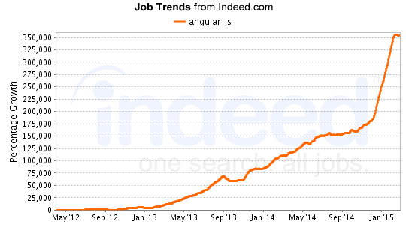
Global Opportunities

Slide 5
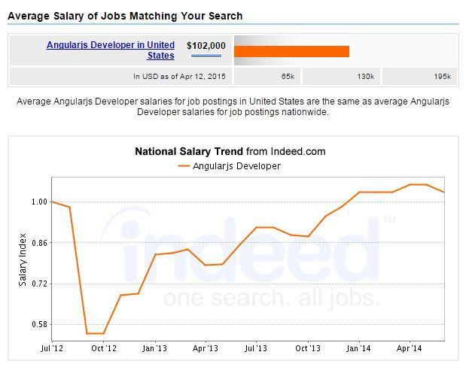
Salary Trend

Slide 6

What is AngularJS?
AngularJS was originally developed in 2009 by Misko Hevery and Adam Abrons at Brat Tech LLC, firstly named as GetAngular
Now its an OpenSource client side JavaScript framework created by Google
It designed for web developers and designers, who needs to have more control over their web Applications
For a web developer, it means having a rich feature that allows them to add more value to the client side of the applications
AngularJS accomplishes a lot by embracing HTML, JavaScript and CSS

Slide 7

A better way to think about angular is not to think about it as framework but as HTML compiler which allows you to create your OWN DSL in HTML, by attaching your own behavior to any HTML element, attribute or text. And by any I mean that you can make up your own names (outside those of HTML spec)
Misko Hevery

Slide 8
Challenges of Web Development
Device: Need to adapt user interface to a wide variety of devices like laptops, mobile-phones, tablets running on different operating systems
User Preferences: Diverse User preferences in viewing data ranging from spreadsheets to charts
Skill Sets: Resource skills rarely cover all aspects of development. A good graphic designer usually does not have coding skills and vice-versa
Agility: Need to rapidly service new requests for information in a highly competitive environment faced by enterprises

Slide 9
Why You Should Learn AngularJS?
More control
Simplicity
Testing
Flexible and Extensible
Popularity
AngularJS has numerous features that allow it to expand the capabilities of web applications beyond basic HTML, CSS, and Javascript
With features like two-way data binding, custom directives and services, and client-side validation, AngularJS is much more dynamic and flexible

Slide 10
Why You Should Learn AngularJS?
More control
Simplicity
Testing
Flexible and Extensible
Popularity
AngularJS is clean and easy to use
The main objective of AngularJS is to simplify web development experience
AngularJS in spite of it being heavy duty capabilities makes it look so uncomplicated and easy

Slide 11
Why You Should Learn AngularJS?
More control
Simplicity
Testing
Flexible and Extensible
Popularity
The main focus of AngularJS is to be testable
AngularJS takes out the difficulty of unit testing of the codes, with the help of MVC framework and efficient development methods
This tool also includes an end-to-end scenario runner for automated unit testing scripts with minimum code

Slide 12
Why You Should Learn AngularJS?
More control
Simplicity
Testing
Flexible and Extensible
Popularity
AngularJS is very accommodating when it comes to integrating with the existing technology stack
As a Javascript client-side tool, it can be used with any server-side technology that is in use
It also gets along with other client-side technologies, and can be customized in such a way that it is not interfering with the existent setup

Slide 13
Why You Should Learn AngularJS?
More control
Simplicity
Testing
Flexible and Extensible
Popularity
AngularJS has been widely used since 2010 and its usage and popularity continues to grow
Numerous Fortune 500 companies along with startups are implementing AngularJS
The demand for AngularJS has become so high that it has become an essential skill for Developers

Slide 14
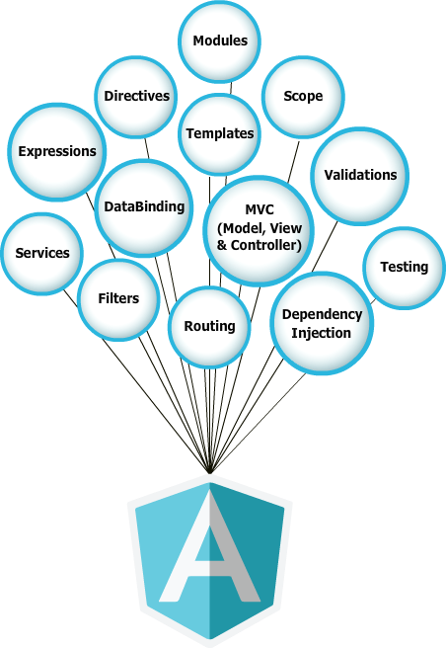
Features of AngularJS

Slide 15
JavaScript MVC framework
The MVC pattern separates the application into 3 concerns
Model: The model is responsible for all behaviour and data of the application. It is responsible for managing data, this included all creation, retrieval, update and delete of data
View: This layer is responsible for the presentation of data and user interaction
Controller: This component handles the interaction between the View and the Model
Controller
User action
Update
Update
Notify
Model
View

Slide 16
Advantages of MVC
Separating Model from View (that is, separating data representation from presentation)
Easy to add multiple data presentations for the same data
Facilitates adding new types of data presentation as technology develops
Model and View components can vary independently enhancing maintainability, extensibility, and testability

Slide 17
AngularJS: Architecture
HTML
Browser
AngularJS
Static
DOM
DOM Content Load Event
ng-app=“application name”
$injector
$compile
$rootscope
Dynamic
DOM
$compile(dom, $rootscope)

Slide 18
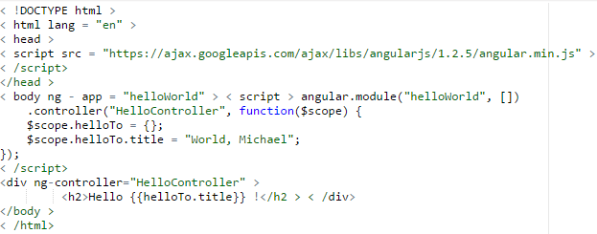
AngularJS: Your first program
Steps to create an AngularJS Application
Include AngularJS
Bootstrap the App
Create the Controller
Create the View
Run the Application

Slide 19
Building Highly Responsive Single Page Application
Usecase : Build a User Management Application
Prerequisite :
Text Editor (sublime or notepadd ++)
Latest browser (Firefox or Chrome)
Installed NodeJS (server)
Mongo (To store userinfo)
Project Specifications :
Login to the Application
Create a new user
View Users List
Update a existing user
Delete user
Signout

Slide 21
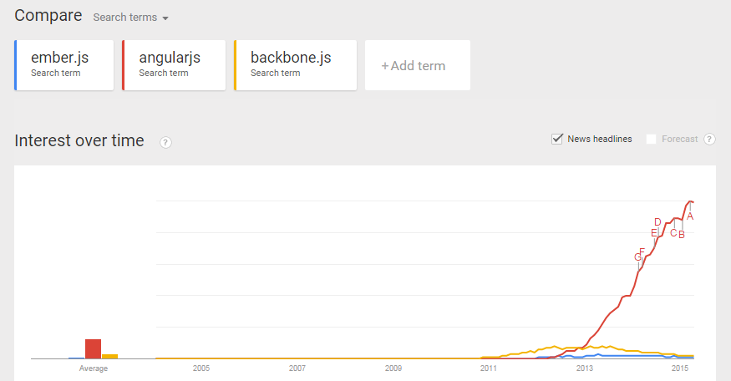
AngularJS Vs Backbone.js Vs Ember.js
 | AngularJs | Backbone.js | Ember.js
Dependencies | No Dependencies | Underscore.js , jQuery | Handlebars, jQuery
Data Binding | Fully Supported | Needs plugins to support | Fully Supported
Routing | Simple | Simple | Complex
Testing | Awesome test support | No default test solution | Poor testing initially, good test support now

Slide 22
Course Topics
Module 1
Introduction to JavaScript MVC Framework and AngularJS
Module 2
Dependency Injection and Controllers
Module 3
Route, Directive and Filters
Module 4
Creating Custom Directives and Filters
Module 5
Third-party AngularJS Modules and Testing Angular
Module 6
AngularJS with Node.js
Module 7
Project Discussion

Slide 23

Exclusive
“On AngularJS Course for Webinar Participants”
Visit: http://www.edureka.co/angular-js
To avail this offer please contact us:
US : 1800 275 9730 (toll free)
INDIA : +91 88808 62004
Email Us : sales@edureka.co

Slide 24
Course Features

